Slide 1
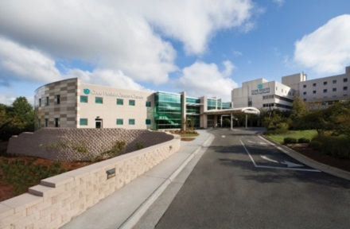
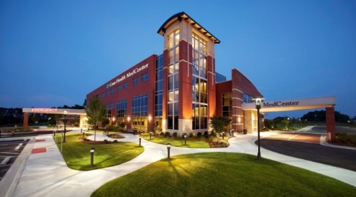
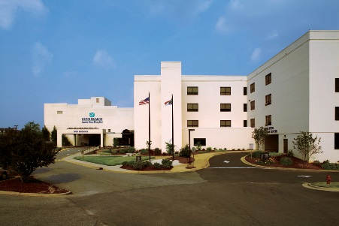
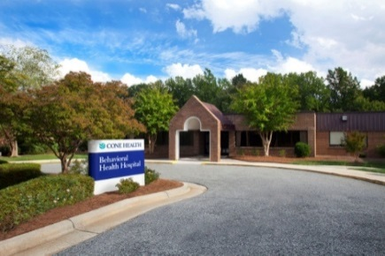
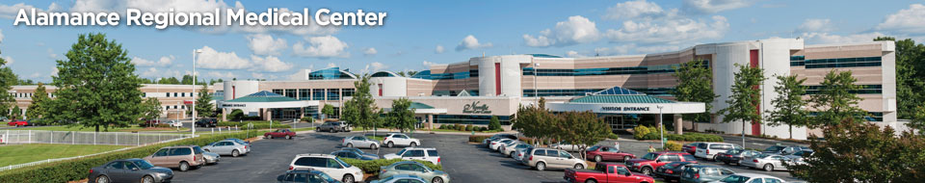
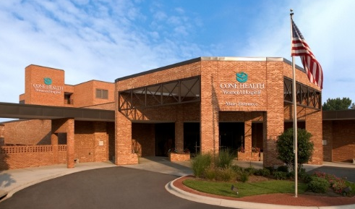

Welcome to
Cone Health
Notes:
2017
Top left to right: WL / MCHP / AP
Middle: BHH / ARMC / WH
Bottom: MC
10,000+ employees
Largest private employer in Guilford County
6 hospitals (1200+ beds)
100+ Physician Practices
Four Urgent Care Centers

Slide 2

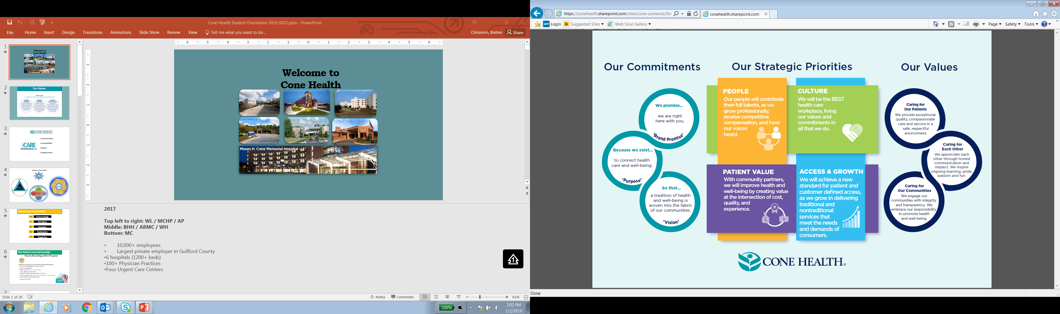
Our Strategic Plan
Notes:
Now you are a part of the Exceptional people who make up the Cone Family. Everyone must be committed to the Cone Health Values and Commitments.

Slide 3


Communication
Accountability
Respect
Empowerment
Notes:
iCare is the way we show our value of caring

Slide 4
Patient Care Partnership
A
Acknowledge
I
Introduce
D
Duration
E
Explanation
T
Thank You
Notes:
Acknowledge the patient and visitors. Say “hello.”
Introduce yourself and state your business. Why you are there and what you hope to accomplish.
Duration- If there is a delay in treatment tell the pt. how long the wait will be.
Explanation Tell the pt. why you are doing the treatment and/or giving the medication etc.
Thank You-
Thank the pt. for allowing you to care for him/her

Slide 5
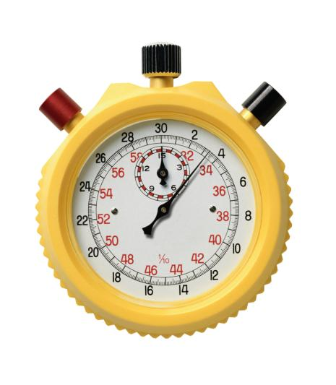

The Patient Care Partnership
Hourly Rounding with a Purpose
8 Behaviors important to Hourly Rounding with Purpose:
Use warm acknowledgement to reduce anxiety
Perform scheduled tasks
Address the 3 Ps (Pain, Potty, Positioning)
Assess additional comfort needs
Conduct an environmental assessment of the room
Prior to leaving the room, ask, “Is there anything else I can do for you?”
Tell each patient when you will be back
Document the round
Notes:
In addition to our internal models of patient care to guide our practice, we have several accrediting bodies we are accountable to – TJC (The Joint Commission), CMS (Centers for Medicare and Medicaid) American Hospital Association …
TJC gives is 2015 NPSGs:
1.ID patients correctly – Red Rule
2. Improve Staff Communication – Hand-off/ Hall pass
3. Use medicines safely – 5 rights / pharmacy unit-dose dispensing / medication bar-code scanner
4. Prevent Infection – Admission screening / isolation / post-op measures
5. ID patient safety risks – yellow arm band
6. Prevent mistakes in surgery – Red Rules
7. Use alarms safely
AHA Patient Care Partnership replaced Patient’s Bill of Rights - 2001
At Cone Hourly Rounding with a Purpose addresses these components
Informed
Choice
Access
Decisions
Respect
Confidentiality
Complaint Appeal
Responsibilities
Posted at admission desks and in patient admission folder provided to each patient on admission.

Slide 6



Important Initiatives
Handwashing
Fall Prevention
#1 way to prevent HIAs
Every time you cross the threshold!
FROG – friction rubs out germs
Ribbit
Yellow armband & Yellow socks
Other things that can be done?
Notes:
HIAs – Hospital Acquired Infections – CAUTIs / CLABSIs / Post Op / VAP – Ventilator Assisted Pneumonia

Slide 7


HIPAA and Corporate Compliance
Special Note
Privacy Flag in CHL
= Strict Privacy
Refrain from sharing experiences on social media
Save Trees & Confidentiality –
Please, no printing!
Notes:
When someone asks for that person by name, state, ”There is no record of that person being in the facility.”
If compromise, Safety Zone Portal (SZP). portal
BHH will have special practices regarding their patients that you will be oriented to when you go there.

Slide 8
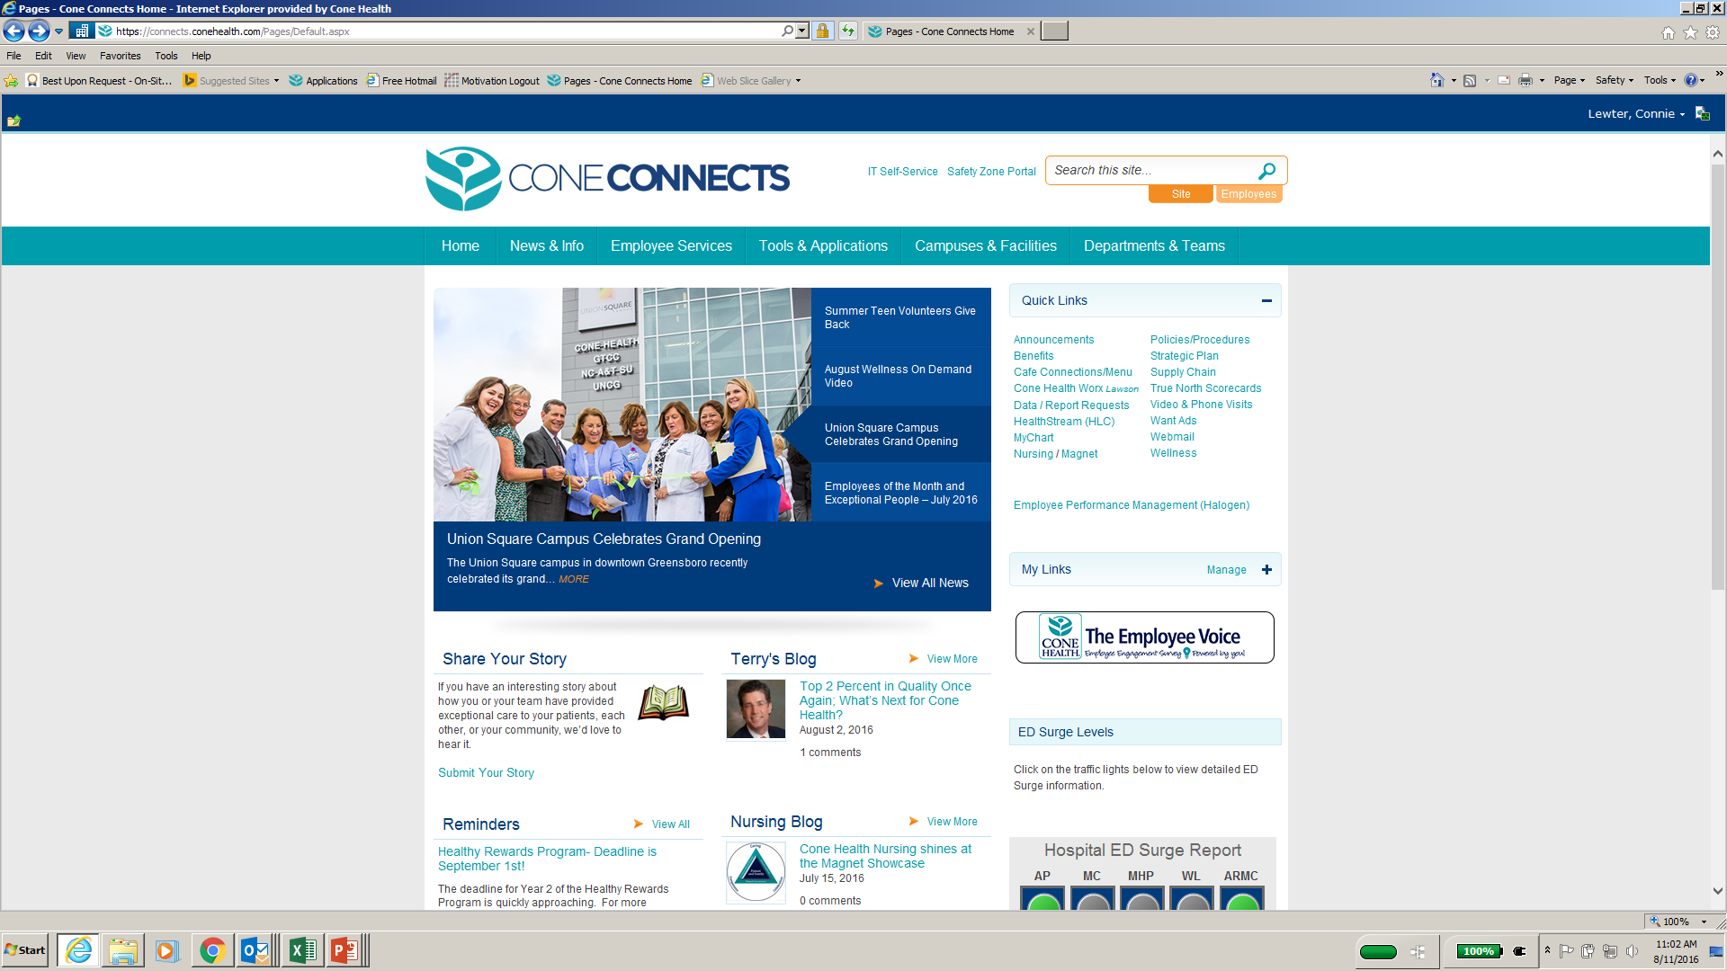
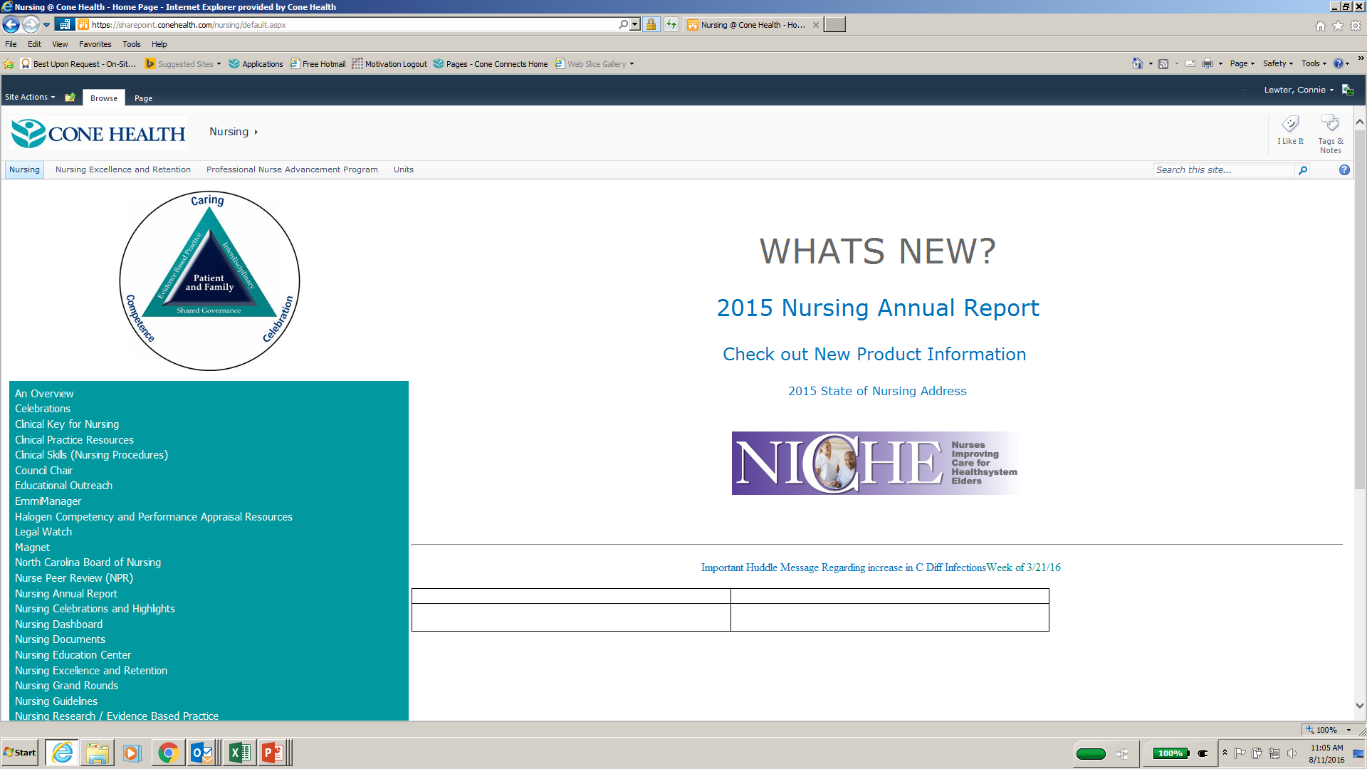
Resources – Cone Connects intranet
Clinical Key for Nursing / Clinical Skills Nursing Procedures
Information about diagnoses, meds, labs; journal articles; patient education materials
Click here
Then here
Notes:
Information about a variety of diagnoses
Nursing Journals and Books that you can actually read on line.
Patient Education Materials
Medication Resources and drug calculators

Slide 9

Policies and Procedures
Cone Healthlink
Assist Desk at (2) 7242
Self-Serve Password reset instructions / The last 4 SSN = last 4 Student ID
Protect computer IDs or passwords
Viewed for your patient only
Cone Health Employees will need a 2nd ID for student / faculty role use
Notes:
Contact the Assist Desk at (2) 7242 for any trouble accessing CHL after you receive a log-in.

Slide 10
SAFETY ZONE PORTAL
Events inconsistent with Cone Health Policies & Procedures, or not part of routine care. SZP reports lead to appropriate follow up.
The Event will be documented in patient chart
SZP records are not documented in patient’s chart
Notes:
Risk Management
Any incident, which may have adverse consequences for patients, visitors, faculty/student should be reported immediately to Leadership on the department and a safety Zone Portal entry completed.
Report any incident immediately to your instructor / nurse
Serious & Non-Serious
Sentinel Events – death or permanent loss of function - immediately contact DD & RM. RCA – Root Cause Analysis / lit review / action plan
Goal: risk identification, risk evaluation, claims management
Minimize loss & improve quality of medical services and safety.
Appropriate Follow up by Department Director and Risk Management Department
Event to be factually documented in patient chart

Slide 11

Policies and Procedures
Ethical Issues / Interpreters
The patient’s primary nurse and your instructor can contact Pastoral Care to request an Ethics Consult or an Interpreter if needed
The American Nurses Association (ANA) Code of Ethics for Nurses provides guidelines for practice.
Notes:
Cone Health offers Ethics Consultation for patients, families, medical staff and ancillary staff involved in patient care.

Slide 12
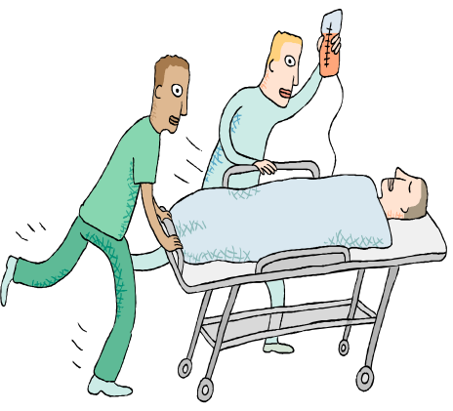
Policies and Procedures
Rapid Response Team (RRT)
Provides early and rapid intervention for patients outside the ICU setting whose condition is deteriorating.
CONDITION HELP
A Safety Net Program for Patients and Families
Ability for patients and families to activate a call for help from any hospital phone
Notes:
Critical Care team responds to a call for critical care expertise to the patient’s bedside to assist with stabilizing and transferring to a higher level of care as needed
Purpose is to provide early and rapid interventions for more positive outcomes
Identify Early Warning Signs
Refer to Facility’s process for managing unstable patient situations

Slide 13
EMERGENCY CODES - Plain Language
Event | Sample Scripting
Evacuation | Overhead: Your attention please, Facility Alert, Immediate Evacuation, Unit 5Central.
Fire / Smoke Alarm | Overhead: Your attention please, Facility Alert, Fire Alarm activation Unit 5North.
Hazardous / Materials Spill | Overhead: Your attention please, Facility Alert, Chemical Spill, 1st Floor Laboratory.
Mass Casualty | Overhead: Your Attention Please, Facility Alert, External Mass Casualty Incident, Emergency Department.
Utility / Technology Interruption | Overhead: Your Attention please, Facility Alert IT Network Downtime, Implement downtime procedures
Weather | Overhead: Attention, Facility Alert Tornado Warning. Move away from windows to interior portions of the building.
Missing Infant / Child | Overhead Page: Security Alert Missing Infant, male infant, last seen in room 322.
Notes:
Previous emergency codes – Code red for fire, green for disaster, gray for restricted, pink for abduction.
Designed to avoid causing panic in patients and families.
Very attuned now; not fooling anyone.
Change is congruent with our goal of transparency
Also in accordance with the American Hospital association - Goal of standardization – minimizes confusion and errors
Code Blue – medical emergencies are typically going to be sent by pager not overhear; if overhead scrip would be “medical emergency and the
location”.
Bomb Threat / Suspicious Package – radio to security officers

Slide 14
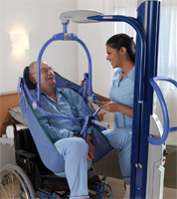
Safe Patient Handling
POLICY: All patient transfer/ lifting will be done safely and appropriately to protect the employee and patient from injury.
Maxi Move- Lifting and transfer device for the totally dependent individual
  Safe to transport throughout the facility
  Weigh individual during lifting
Consult with the patient’s nurse
and your clinical instructor for guidance.
Notes:
Tubes & slides reduce friction and provide a
safer, more comfortable move for patients

Slide 15
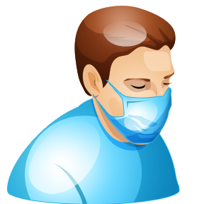
Safe Patient Handling
Isolation – Signage on doors with instructions. Do not enter patient’s rooms that require a special mask
Consult with the patient’s nurse and your clinical instructor for guidance.
Notes:
Equipment and signage to keep the patient and YOU safe from harm.
Able to lift from floor, bed, chair, toilet/bathing area and other areas
Sized from x-small to x-large and various specialty slings (e.g. amputee slings)
ARMC – same color now
Students are not Fit Tested and should not be assigned to patients requiring that type of PPE

Slide 16

Team Communication Method
General Guidelines
SBAR – Effective communication tool. Consistent and organized to promote patient safety
Gather information prior to communication
Situation
Background
Assessment
Recommendations
Notes:
Used for reports, hand-offs and phoning a provider
Situation – ID self, patient & location. Briefly describe situation and severity.
Background – Adm date & dx, recent surgery or procedures & dates,
Assessment – RN assessment
Recommendations – based on your assessment, pathways and situation
Phoning a provider or rapid response … gather information prior to communication: MR, current meds, IVs, allergies, recent VSs, new labs and pertinent trend info, Code Status

Slide 17

Communication Tools
SRAR / HAND-OFF / HALL PASS
Use for Internal and external transfer of care
  Shift Report
  Coverage for lunch / breaks
  Critical Lab and Radiology Results
Requires uninterrupted time
  Requires ability to ask questions
  Include the patient when possible

Slide 18

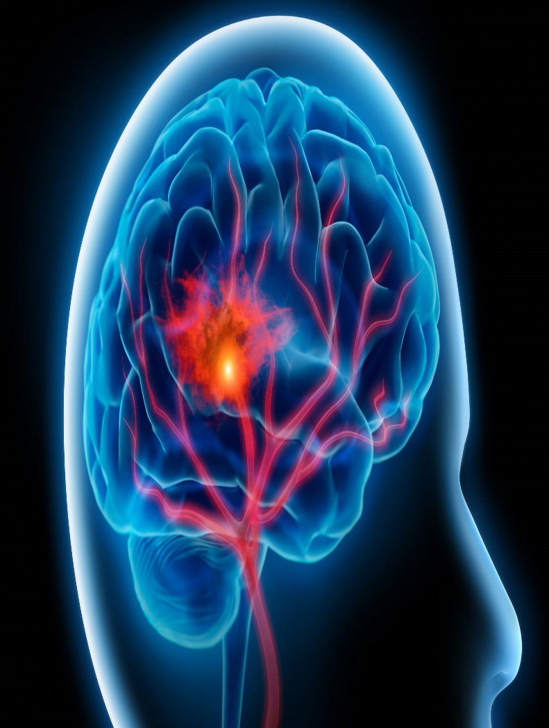
Cone Health is a Certified
Chest Pain & Stroke Center
All personnel are
required to know:
Heart Attack Symptoms
Code Stroke Symptoms
What to Do

Slide 19


Heart Attack Symptoms
Chest discomfort
Pressure, heaviness
Squeezing, tightness
Burning
May come & go
Lasts more than 2 minutes
Pain felt in one or both arms, the back or the neck
Shortness of breath. Breaking out in a cold sweat
Nausea, vomiting. Light headedness
Extreme weakness, fatigue
Can occur in women and young people
If you witness a patient, employee or visitor with these symptoms, get help immediately. Transport to ED or call 911.

Slide 20

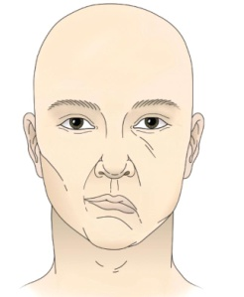

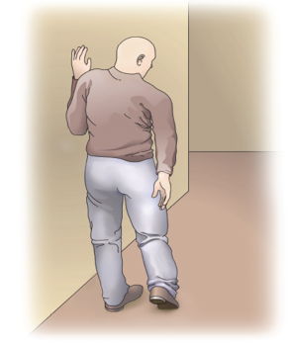


Stroke (Brain Attack) Symptoms –
Remember BE FAST
Behavior changes, headache
Eye – vision changes
Facial droop on one side
Ambulation difficulty
Speech slurred
Time is critical
Get Help Fast!
If you witness a patient, employee or visitor with these symptoms, get help immediately. Transport to ED or call 911.
“BE FAST was developed by Intermountain Healthcare, as an adaptation of the FAST model implemented by the American Stroke Association. Reproduced with permission from Intermountain Healthcare. Copyright 2011, Intermountain Healthcare.”

Slide 21
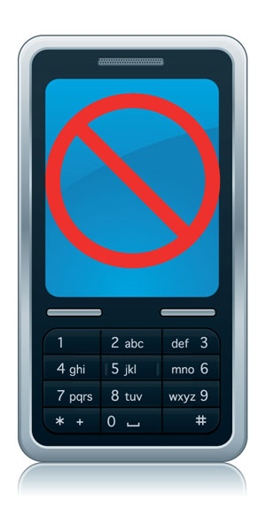
General Guidelines
Phones/Valuables
• Personal phone calls should be limited to emergencies.
• Personal cellular phones are to be turned
off and not used in
clinical settings.
• Storage is limited for personal belongings.
• Valuables cannot be secured.
Avoid social media posts.
Caution topics for public conversations
Printing materials is prohibited
Notes:
Orientation – make sure you get the department phone number and give it and your schedule to your significant others.
HIPAA – don’t even give the impression you are talking about a patient.

Slide 22

General Guidelines
Student Parking
Carpooling is strongly encouraged on each campus.
Moses Cone Hospital –3rd level of the Visitor Garage accessed from Church Street
Wesley Long Hospital – Employee parking lot located off N. Elam and Friendly avenues.
Women’s Hospital –Upper Employee Lot
Annie Penn Hospital Employee parking lot located adjacent to the South Main Street exit of the hospital lot.
Behavioral Health Hospital – Upper middle lot and to the left of the building.
Alamance Regional Medical Center – S Lot across from Medical Mall entrance

Slide 23

THANK YOU
We are confident you will have an exceptional learning experience at Cone Health.
Please sign the
Orientation Acknowledgement Form and give to your Faculty

